Slide 1
AI Test - Winter 30
Dec 2025

Slide 2
Agenda
The Synthetic Radio Host
The Financial Detective
The YouTube Miner
RFP Doc ChatBot
YouTube to Docx

Slide 3
The Synthetic Radio Host
Objective
The Task: Build a Python pipeline that takes a Wikipedia article (e.g., about "Mumbai Indians"), generates a natural-sounding 2-minute conversation script between two people in Hinglish (using an LLM), and then converts it into audio using a TTS API (OpenAI/ElevenLabs/Bark).
The Constraint: The audio must sound conversational (interruptions, "umm," "achcha," laughter). It cannot sound robotic.
The Deliverable:
The Python Script (Colab link).
One MP3 sample.
A 100-word explanation of how you prompted the LLM to get "Hinglish" style right.
High-Level Program Flow
1. Ingestion Layer (Wikipedia-API): Fetches the raw article data for "Mumbai Indians" and stores it as a text string for processing.
2. Intelligence Layer (Groq & Llama 3.3): The "Brain." It takes the raw Wikipedia text and a persona-based prompt to transform factual data into a natural-sounding Hinglish dialogue script.
3. Parsing Layer (Python Standard Library): Acts as the "Logic Controller." It splits the generated script line-by-line and identifies which character (Raj or Pallavi) is speaking to assign the correct voice.
4. Synthesis Layer (ElevenLabs): The "Voice Box." It converts each line of text into a high-fidelity audio fragment using specific Male/Female Voice IDs and the Multilingual v2 model.
5. Assembly Layer (Pydub & FFmpeg): The "Editor." It stitches the individual audio fragments together, adds 500ms of natural silence between speakers, and exports the final MP3 file.

Slide 4
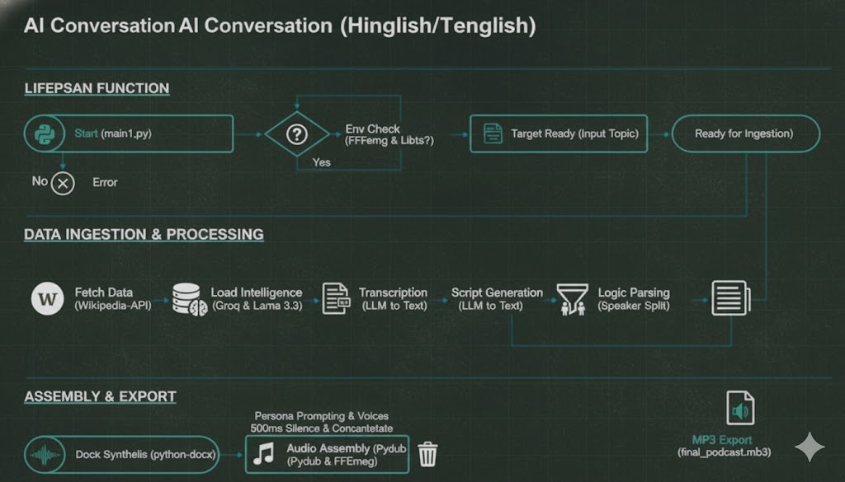
The Synthetic Radio Host – System Architecture
Used Groq to create script on the basis of Wikipedia page, Groq accelerates AI inference for real-time applications like natural language processing, computer vision, and high-performance computing tasks.
# --- 3. INTELLIGENCE (Script Generation) ---
def generate_hinglish_script(context):
print("Generating hinglish script via Groq...")
prompt = f"""
Context Data: {context}
Task: Write a natural 2-minute Hinglish conversation between RAJ and MEENA.
Style: Use 'Mumbai' Hinglish. Mix Hindi and English naturally. Keep 50% English and 50% Telugu.
Format:
Raj: [dialogue]
Meena: [dialogue]
"""
response = client_groq.chat.completions.create(
messages=[{"role": "user", "content": prompt}],
model="llama-3.3-70b-versatile",
)
return response.choices[0].message.content

Slide 5

Features & Deliverables
Feature | Technical Implementation | User Benefit
Authenticity | Code-Switching Prompting | Sounds like a real Indian podcast.
Modularity | Decoupled API Layers | Easy to swap Gemini for Groq or OpenAI.
Human-like Flow | 500ms Inter-line Silences | Removes the robotic, continuous drone.
Scalability | Python-based Automation | Can generate 100 podcasts as easily as one.
Deliverables
Category | Deliverable Item | Purpose
Media | final_multi_voice_podcast.mp3 | The final user-facing product.
Code | Python Source Code | Demonstrates technical implementation and modularity.
Logic | Script Text File | Verifies the quality of the Hinglish generation.
Architecture | Architecture Diagram | Explains the "How" for technical stakeholders.
https://colab.research.google.com/gist/raj-aws/dc8334ff949d423bed0e57fd168ba0e2/pymain.ipynb#scrollTo=bd108afc

Slide 6
The Financial Detective
Objective
The Task: Take the provided raw text file (a messy 5-page excerpt from a Reliance Annual Report). Write a script that extracts specific Entities (Company Names, Risk Factors, Dollar Amounts) and Relationships (e.g., Reliance Retail -> OWNS -> Hamleys) and outputs them into a strict JSON Knowledge Graph format.
The Constraint: You cannot use regex. You must use an LLM (local Llama or GPT-4o) to do the extraction. The JSON schema must be valid.
The Deliverable:
The Python script.
The graph_output.json file.
A visual representation (screenshot) of the graph (using a library like NetworkX or just a Mermaid chart).
High-Level Program Flow
Ingestion Layer (Python Standard Library): Reads the reliance_report.txt file into a string.
Validation Layer (Pydantic): Acts as the "Guardrail." It defines the schema (Entities and Relationships) that the LLM must follow. It prevents the AI from returning random text.
Intelligence Layer (Ollama & Llama 3): The "Brain." It takes the raw text and the schema, performs a semantic analysis of the financial data, and generates a structured JSON response.
Graph Layer (NetworkX): Converts the JSON "Triples" (Subject-Predicate-Object) into a mathematical graph object.
Visualization Layer (Matplotlib): Renders the graph into a PNG image for human review.

Slide 7
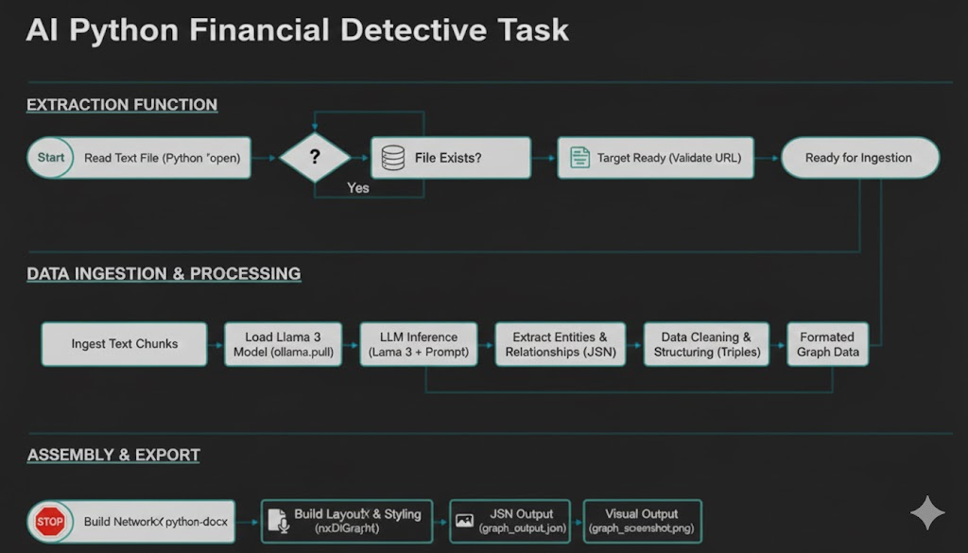
The Financial Detective- System Architecture

Slide 8
Features & Deliverables
Feature | Traditional Approach (Regex) | Our Approach (AI/LLM)
Flexibility | Breaks if text format changes slightly. | Understands context even if format is messy.
Complex Logic | Hard to find "Risk Factors" with rules. | Easily identifies sentiment and risks.
JSON Safety | Needs manual string parsing. | Pydantic ensures 100% valid JSON schema.
Deliverables
Deliverable | Format | Purpose
Code | .py | Proof of logic and cleanliness.
Data | .json | The actual extracted intelligence.
Visual | .png | Human-readable summary of the report.

Slide 9
The YouTube Miner
Objective
The Task: Write a Python script that takes a YouTube URL (e.g., a specific podcast episode), and does three things automatically:
Downloads the audio.
Uses VAD (Voice Activity Detection) to chop it into clean 30-second chunks (removing silence/music).
Transcribes one chunk using a distinct Open Source model (like Whisper-Tiny) and compares it to the YouTube auto-captions.
The Constraint: No paid APIs. Use open-source libraries ( yt-dlp, pyannote, faster-whisper).
High-Level Program Flow
1. Ingestion Layer (yt-dlp): Acts as the entry point. It fetches the raw audio stream and official subtitle data (auto-captions) from the provided YouTube URL. The audio is then converted into a high-fidelity WAV format for processing.
2. Segmentation Layer (Pydub & FFmpeg): The "Slicer." It takes the raw audio file and cuts it into a clean, 30-second fragment. This layer ensures that the system focuses only on a specific, manageable chunk of speech as requested by the task.
3. Intelligence Layer (Faster-Whisper): The "Brain." This local open-source AI model runs Voice Activity Detection (VAD) to ignore silence and background noise. It transforms the 30-second audio fragment into a structured text script with proper punctuation and capitalization.
4. Parsing Layer (VTT Cleaner): Acts as the "Logic Controller." It parses the downloaded YouTube .vtt file, stripping away technical metadata, headers, and timestamps to leave only the raw spoken text for a fair comparison.
5. Evaluation Layer (Difflib): The "Validator." It performs a side-by-side comparison between the AI-generated text and the official YouTube captions. It calculates a similarity score and generates a professional HTML visual report highlighting the differences.

Slide 10
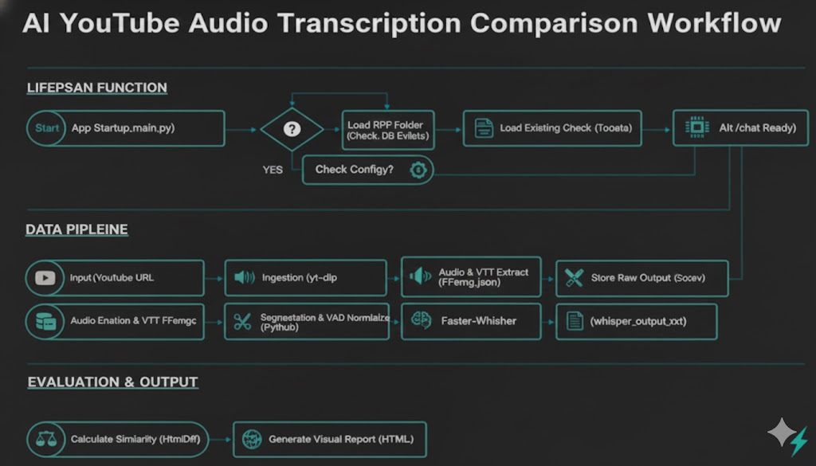
The YouTube Miner – System Architecture

Slide 11
Features & Deliverables
Feature | Traditional Approach (Basic Scripts) | Our Approach (AI/Whisper)
Speech Detection | Uses simple volume thresholds; often captures noise/static. | Intelligence Layer uses VAD to isolate human voice from background music.
Contextual Accuracy | Relies on phonetic matching; struggles with accents/jargon. | Whisper AI understands context to provide accurate punctuation and grammar.
Data Integrity | Manual string cleaning for VTT files is prone to errors. | Parsing Layer automates VTT cleaning and ensures 1:1 comparison with AI text.
System Reliability | Standard APIs often return "No Element Found" or rate-limit blocks. | Ingestion Layer uses yt-dlp and local inference to bypass network blocks.
Validation | Visual check only; hard to quantify accuracy. | Evaluation Layer provides mathematical Similarity Scores and HTML diff reports.
Deliverables
 | Format | Purpose
Processed Audio Chunk | .wav | A 30-second high-fidelity slice of the original video. It proves that the VAD (Voice Activity Detection) and chopping logic worked correctly.
YouTube Baseline | .vtt | The original "auto-caption" file downloaded from YouTube's servers. This acts as the "control" group for the experiment.
Whisper AI Transcript | .txt | The final, clean text output generated by the local AI. This file typically includes improved punctuation and capitalization compared to the baseline.
Comparison Report | .html | An interactive report showing a side-by-side "diff." It highlights exactly which words the AI added or corrected and provides a mathematical Similarity Score.

Slide 12
RFP Doc ChatBot
Objective
The Task: Write a Python script that reads all RFP documents in a folder tokenize them and store in a persistent vector database, Create a chatbot which will answer questions on the documents
The Constraint: No paid APIs. Use open-source libraries
High-Level Program Flow
Layer/Action | Description
Data Sourcing | Collect existing RFP responses, core competencies, white papers, and technical documents from internal repositories.
Document Preprocessing | Standardize documents by converting tables to structured text, recognizing hierarchies (headers, sections), and running OCR on diagrams.
Strategic Chunking | Break documents into manageable "chunks" (e.g., paragraphs or recursive sections) while maintaining context through semantic markers.
Embedding Generation | Use an embedding model (like nomic-embed or OpenAI) to convert text chunks into numerical vector representations.
Vector Storage | Store vectors and associated metadata (source name, last updated, version) in a database like ChromaDB or Pinecone.
Query Processing | The system receives a user question and converts it into a vector embedding using the same model from Step 4.
Semantic Retrieval | The retriever searches the vector database for chunks most similar in meaning to the user's question.
Prompt Augmentation | Combine the user's original question with the retrieved chunks and a system prompt (instructions) into one detailed request for the AI.
Response Generation | The Large Language Model (LLM) generates a factual answer strictly based on the provided "context" chunks.
Citations & Output | Return the answer to the user, including direct links or names of the source documents to ensure transparency and trust.

Slide 13
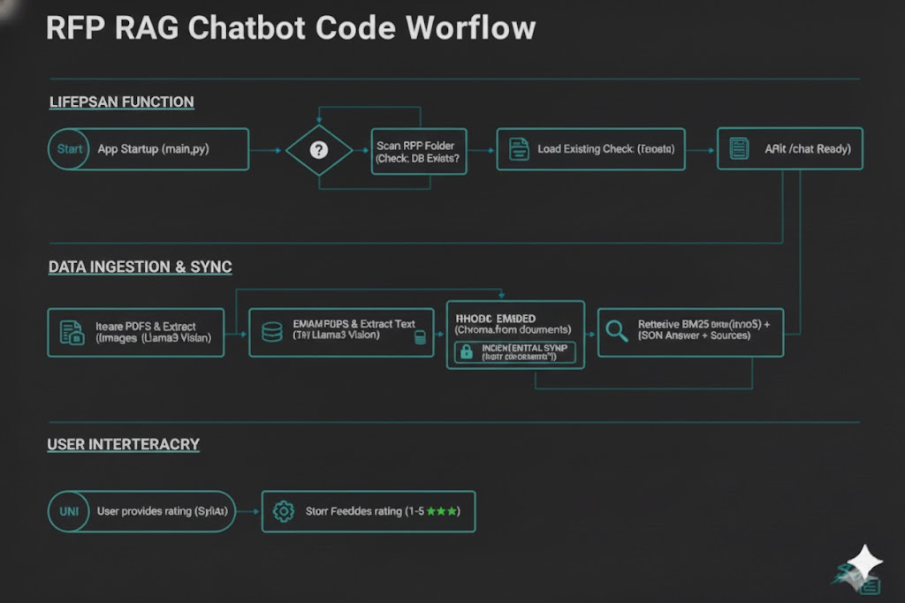
RFP Doc ChatBot – System Architecture

Slide 14
Features & Deliverables
Feature | Traditional Approach | Our Approach (RAG Chatbot)
Knowledge Access | Static & Siloed: Teams rely on "Tribal Knowledge" or search through disjointed folders and past emails. | Dynamic & Centralized: Connects to a "Single Source of Truth" (Vector DB) containing all up-to-date company documents.
Response Accuracy | Prone to Error: Manual copy-pasting leads to outdated technical specs or "hallucinations" (made-up facts). | Grounded in Facts: AI retrieves real document chunks before answering, drastically reducing errors and hallucinations.
Search Mechanism | Keyword Matching: Limited to exact word matches (Ctrl+F), often missing relevant but differently phrased info. | Semantic Search: Understands the meaning of questions; finds relevant info even if the vocabulary differs.
Data Updates | Retraining/Manual Edits: Requires expensive model retraining or manual database cleanup to add new info. | Instant Indexing: Simply upload a new PDF to the folder; the system indexes it in minutes without retraining.
Trust & Verification | Blind Faith: Hard to verify where a team member got a specific answer without deep manual digging. | Automated Citations: Every answer includes direct links or names of the source documents for instant verification.
Cost & Speed | High Overhead: Takes days/weeks of SME time; labor costs can exceed $5,000 per manual RFP. | High Efficiency: Generates 10x faster drafts; reduces response time by 40–70% and lowers cost per response by half.
Deliverables
Deliverable | Format | Purpose
Vector Database Store | Folder / Binaries | The "Brain" of the system. It contains the mathematical representations (embeddings) of your RFP documents, allowing the AI to perform semantic searches rather than just keyword matches.
Incremental Record Log | .db (SQLite) | The "Memory Map" that tracks file hashes and modification dates. It ensures the system only processes new or updated PDFs, preventing data duplication and saving processing time.
Processed Document Elements | Internal Object / Log | A structured version of your PDFs where tables are converted to searchable text and complex layouts are simplified into manageable chunks.
Visual Data Descriptions | Text / Metadata | Descriptive text generated by the Vision AI (Llama 3.2 Vision) for diagrams and charts found within the RFPs. This makes visual information searchable by the text-based chatbot.
Chat Response & Citations | JSON / UI | The final output provided to the user. It includes a factual answer synthesized from the RFP context and a list of specific source documents used to generate that answer.

Slide 15
YouTube to Docx
Objective
The Task: Build a Python program which will take Youtube URL as input reads only audio from the video and creates and docx file from the audio file with paragraph style
The Constraint: should use only opensource models.
The Deliverable:
The Python Script
Docx file
High-Level Program Flow
Ingestion Layer (yt-dlp): Acts as the "Data Fetcher." It takes the target YouTube URL and extracts the high-quality audio stream, saving it locally as a temporary file for processing.
Intelligence Layer (OpenAI Whisper): The "Brain." It loads a neural network model to process the raw audio file, performing speech-to-text conversion to generate a transcript with precise metadata (segments and timestamps).
Parsing Layer (Python Logic): Acts as the "Logic Controller." It iterates through the raw Whisper segments and groups them into logical paragraphs based on sentence punctuation and count to ensure readability.
Synthesis Layer (Python-Docx): The "Document Builder." It maps the parsed text into a Microsoft Word structure, applying specific font styles, headings, and paragraph spacing.
Assembly Layer (OS & Random Libs): The "File Manager." It generates a unique filename using random strings to prevent overwriting, saves the final .docx file, and performs a cleanup by deleting the temporary audio file.

Slide 16
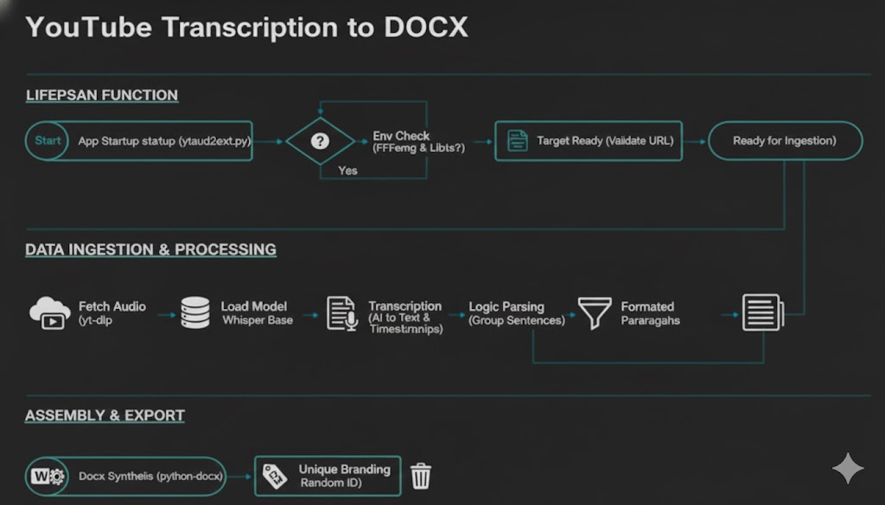
YouTube to DOCX – System Architecture

Slide 17
Features & Deliverables
Feature | Technical Implementation | User Benefit
High-Fidelity Transcription | OpenAI Whisper (Base/Small Model) | Converts complex audio into high-accuracy text, capturing technical jargon correctly.
Intelligent Paragraphing | Heuristic Punctuation Logic | Transforms a single "wall of text" into readable, logically grouped paragraphs for professional use.
Automated Formatting | Python-Docx Library Integration | Saves time by automatically applying headings, font styles (Arial), and metadata without manual editing.
Conflict-Free Exports | Randomized UUID Filenaming | Prevents data loss by ensuring every run creates a unique file, allowing for bulk processing without overwrites.
Hardware Compatibility | FP32 CPU Fallback Execution | Ensures the script runs on standard laptops/PCs without requiring expensive NVIDIA GPUs.
System Hygiene | Automated Temporary File Cleanup | Keeps the local workspace clean by deleting heavy audio files immediately after the document is generated.
Deliverables
Category | Deliverable Item | Purpose
Documents | Formatted .docx Transcript | The final user-facing product featuring unique filenames and readable paragraphs.
Code | Python Source Code (.py) | Demonstrates the technical implementation of Whisper, yt-dlp, and python-docx integration.
Data | Segmented Transcript Data | Verifies the accuracy of the AI transcription and the effectiveness of the paragraphing logic.
Architecture | System Architecture Diagram | Explains the "How" for technical stakeholders, detailing the flow from URL to Word doc.
Environment | requirements.txt / Dependency List | Ensures portability and easy setup of the Python environment and FFmpeg paths.

Slide 18
Thank You

